Slide 3
Thermal Contacts
A
B
C

Slide 4
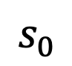
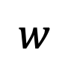
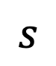
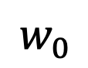
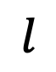
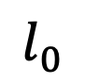
$$s_{0}$$
$$l_{0}$$
$$w_{0}$$
$$s$$
$$l$$
$$w$$

Slide 7

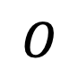
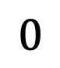
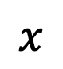
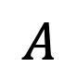
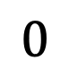
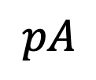
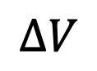
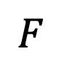
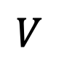
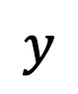
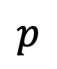
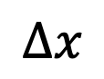
$$y$$
$$p$$
$$A$$
$$x$$
$$O$$
$$pA$$
$$F$$
$$0$$
$$V$$
$$∆x$$
$$0$$
$$∆V$$

Slide 8
p
p
|W| = Area under the curve
|W| = Area under the curve
0
0
0
V
0
V
(a) Work in a process
(b) Work in a cyclic process

Slide 9
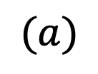
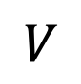
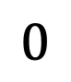
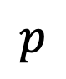
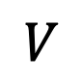
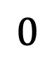
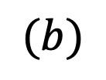
$$p$$
$$p$$
$$0$$
$$V$$
$$0$$
$$V$$
$$0$$
$$0$$
$$(a)$$
$$(b)$$

Slide 10
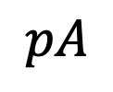
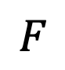
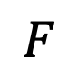
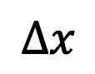
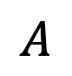
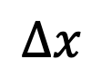
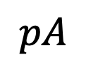
$$F$$
$$A$$
$$pA$$
$$∆x$$
$$A$$
$$F$$
$$pA$$
$$∆x$$

Slide 11
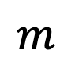
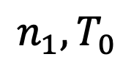
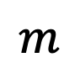
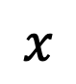
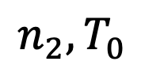
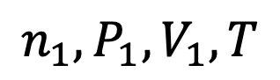
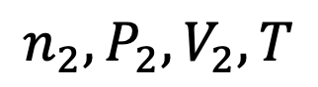
$${n_{1},T}_{0}$$
$$n_{1},P_{1},V_{1}, T$$
Stopper removed
$$m$$
$$m$$
$$x$$
$${n_{2},T}_{0}$$
$${n_{2},P}_{2},V_{2}, T$$

Slide 12
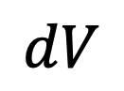
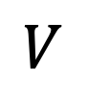
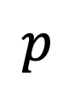
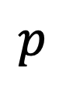
$$p$$
$$p$$
$$V$$
$$dV$$

Slide 13
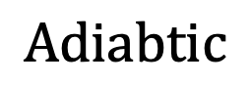
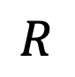
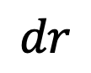
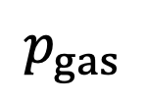
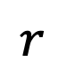
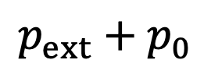
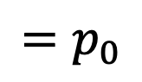




$$p_{0}$$
$$dr$$
$$p_{ext}+p_{0}$$
$$p_{gas}$$
$${=p}_{0}$$
$$r$$
$$R−a$$
$$p_{gas}$$
$$Adiabtic$$
$$R$$
$$R$$

Slide 14



$$T+∆T$$
$$T$$
$$Q$$

Slide 15







$$p_{out}$$
$$T_{out}$$
$$p_{in}$$
$$T_{in}$$
$$T+∆T$$
$$Q$$
$$T$$

Slide 16









$$p$$
$$1$$
$$p_{1}{,p}_{2}$$
$$4$$
$$2$$
$$p_{3}{,p}_{4}$$
$$3$$
$$V$$
$$V_{1}{,V}_{4}$$
$$V_{2}{,V}_{3}$$

Slide 17


Slide 19


Slide 20



















$$p$$
$$B$$
$$C$$
$$Solid$$
$$D$$
$$Critical point$$
$$Liquid$$
$$SL$$
$$LG$$
$$S$$
$$L$$
$$G$$
$$E$$
$$A$$
$$Triple point$$
$$Gas$$
$$O$$
$$T$$

Slide 22


$$B$$
$$A$$

Slide 23










$$Hot Bath$$
$$Q_{H}$$
$$U_{0}+Q_{H}$$
$$U_{0}$$
$$W$$
$$Engine$$
$$U_{0}+Q_{H}−W−Q_{C}$$
$$U_{0}+Q_{H}−W$$
$$Q_{C}$$
$$Cold Bath$$

Slide 24










$$p$$
$$A$$
$$T_{H}$$
$$B$$
$$Q=0$$
$$Q=0$$
$$D$$
$$C$$
$$T_{C}$$
$$V$$

Slide 25




$$Hot Bath$$
$$Q_{H}$$
$$U_{0}$$
$$U_{0}+W+Q_{C}$$
$Refrig$-
$$erator$$
$$W$$
$$U_{0}+W$$
$$Q_{C}$$
$$Cold Bath$$

Slide 26


$$p$$
$$A$$
$$C$$
$$D$$
$$B$$
$$V$$

Slide 27














$$T$$
$$A$$
$$B$$
$$(2)$$
$$(4)$$
$$C$$
$$(1)$$
$$(5)$$
$$(3)$$
$$0$$
$$O$$
$$V$$
$$0$$
$$V_{0}$$

Slide 28




$$p$$
$$(3)$$
$$B$$
$$(2)$$
$$(1)$$
$$A$$
$$O$$
$$0$$
$$V$$
$$0$$

Slide 29












$$p$$
$$p_{2}$$
$$(2)$$
$$p$$
$$(1)$$
$$(2)$$
$$p$$
$$p_{1}$$
$$(1)$$
$$0$$
$$0$$
$$0$$
$$V$$
$$0$$
$$V$$
$$V$$
$$V_{1}$$
$$V_{2}$$

Slide 30










$$p$$
$$(1)$$
$$p_{1}$$
$$T$$
$$(2)$$
$$p_{2}$$
$$0$$
$$0$$
$$V$$
$$V_{1}$$
$$V_{2}$$

Slide 31


$$p$$
$$A$$
$$unknown$$
$$reversible$$
$$B$$
$$V$$

Slide 32





$$X$$
$$Y$$
$$X$$
$$Y$$
$$A_{combo}$$
$$B_{combo}$$

Slide 34





















$$W$$
$$X$$
$$Q_{1}$$
$$Q_{2}$$
$$Q_{n}$$
$$T_{1}$$
$$T_{2}$$
$$T_{n}$$
$$Q_{1}$$
$$Q_{2}$$
$$Q_{n}$$
$$C_{1}$$
$$W_{1}$$
$$C_{2}$$
$$W_{2}$$
$$C_{n}$$
$$W_{n}$$
$$Q_{01}$$
$$Q_{02}$$
$$Q_{0n}$$
$$T_{0}$$

Slide 35





$$P$$
$$T$$
$$V$$
$$V$$
$$2V$$

Slide 36




$$1$$
$$1′$$
$$2$$
$$2′$$

Slide 37


$$v$$
$$v′$$

